Slide 1
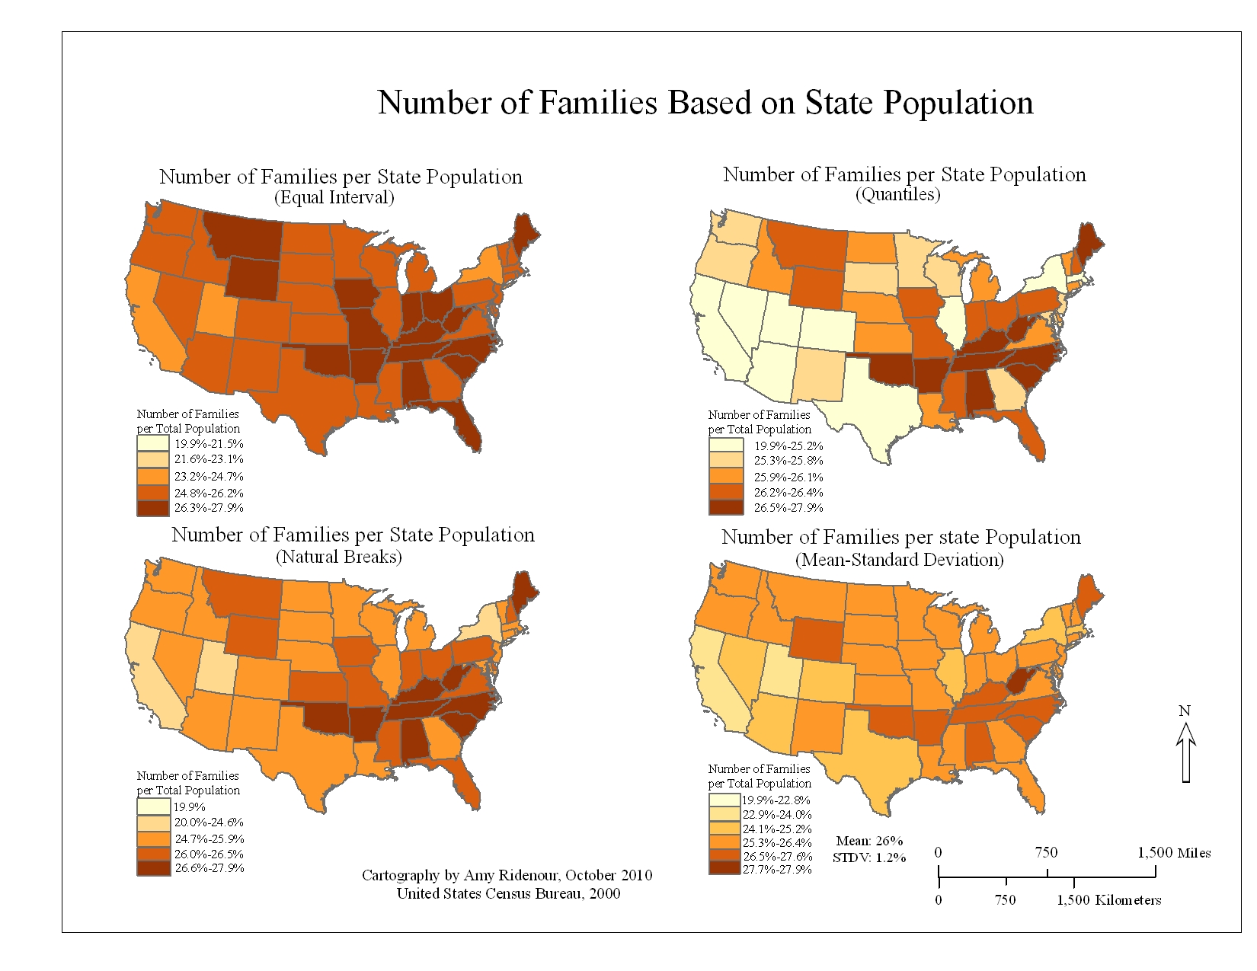
Data classification and central tendency
Geog4300/6300
Jerry Shannon

Slide 2
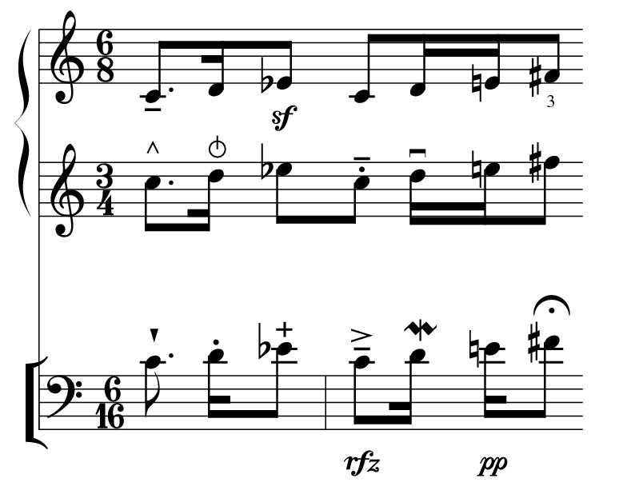
Some notes on notation

Slide 3
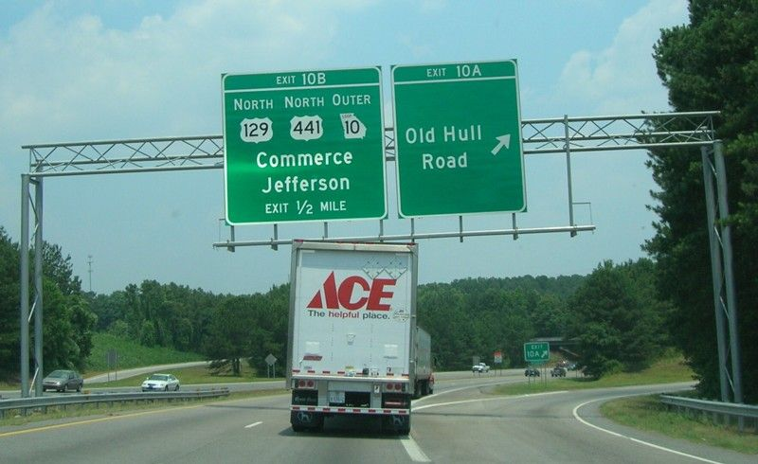
Observations
A set of observations (1, 2, 3, 4) are notated in the following way: x₁, x₂, x₃, x₄,… and so on
An array is the set of all values for a given variable: (x₁, x₂, x₃, x₄,…)
Traffic on the Loop
Minute 1 2 3 4 5
#veh 25 51 29 14 13
n=5 observations

Slide 4
Central tendency: mean
Mean: the average value, represented by x
x = [x₁+x₂+x₃+x₄…x_{n}] / n
the “nth” observation
Traffic on the Loop
Minute 1 2 3 4 5
#veh 25 51 29 14 13
X = (25 + 51 + 20 + 14 + 13) / 5 = 26.4 cars/min.

Slide 5
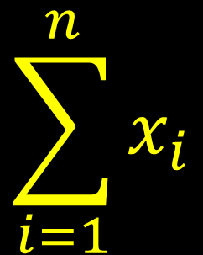
Notation: sum
The [sum of data] and [x₁+x₂+x₃…x_{n}] can be rewritten:
$$\sum_{i=1}^{n}{x_{i}}$$
it’s read as “the sum of x_{i} as i goes from 1 to n”

Slide 6
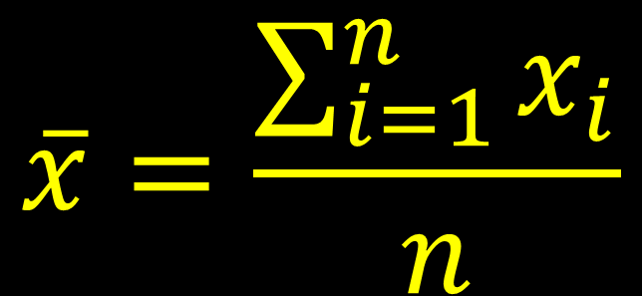
The mean (defined through notation)
“the mean is the sum of all values of x from the first observation to the nth observation, all divided by n.”
$$\overline{x}=\frac{\sum_{i=1}^{n}{x_{i}}}{n}$$

Slide 7
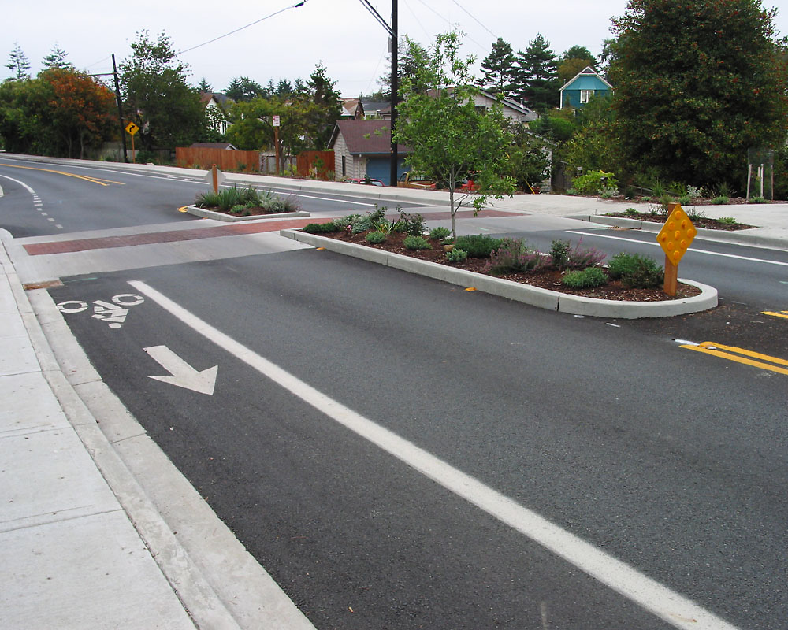
Median
a positional value in the data set: the median is the value that has the same number of smaller values as larger values
a.k.a. the 50th percentile

Slide 8
Finding the Median
Order (sort) the data from smallest to largest
Traffic on the Loop
Minute 1 2 3 4 5
#veh 25 51 29 14 13
Traffic on the Loop
Minute 5 4 1 3 2
#veh 13 14 25 29 51
if n is odd, choose the middle data value
if n is even, take the average of the middle two values

Slide 9
Mode
The mode is the most frequent value.
A variable can have more than one mode, or no mode.
Color of cars observed in minute 4
Blue Green Red
Red Grey Black
Black Black White
Red Green Grey
Silver Red

Slide 10
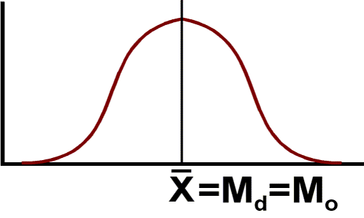
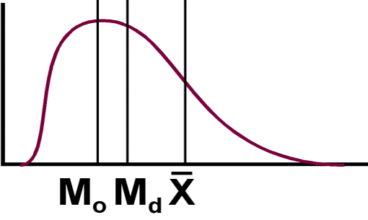
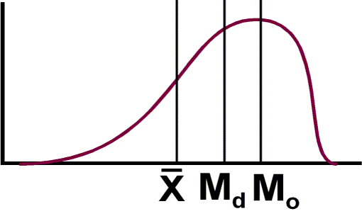
When to use…
Mean: Interval and ratio data, when normally distributed
Median: Ordinal data (or skewed/non-normal data)
Mode: Nominal data

Slide 11

In 1987, the mean salary for graduating geography majors from U. of North Carolina was reported to be over $100,000 per year. Why?
The median income would have been much closer to what the other geographers made…

Slide 12
Calculating in Excel
=AVERAGE()
=MEDIAN()
=MODE()

Slide 13
Calculate the mean, median and mode for the following three census variables in Excel:
LessHS_pct (% with hs degree)
GradDeg_pct (% with graduate degree)
nat_ins_pct (% of naturalized citizens with health insurance)
Which one is best?

Slide 14
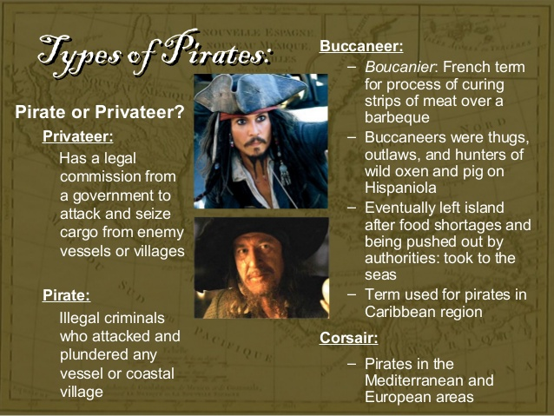
Why is classification necessary?
It brings order to unruly data
Helps communicate findings
Suggests research questions

Slide 15
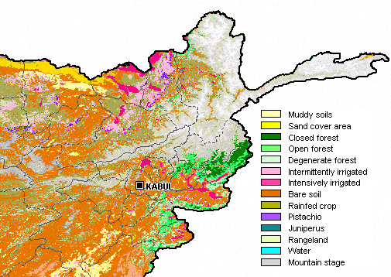
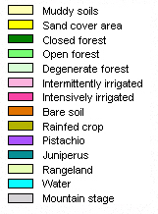
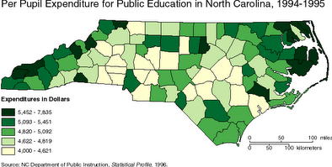
Notes:
What levels of measurement do each of these maps show?
Classification can happen with several different kinds of data.

Slide 16
Categorical classification schemes
Download our survey data from ELC.
Develop a classification scheme for ice cream preferences, between 3 and 5 categories.
Count the responses for each category.
What data distribution results from those classifications?
Notes:
Here’s a dotplot of graduation rate in Georgia counties (created in R using Deducer). What do you notice about it just looking at it?
How could we classify it?

Slide 17
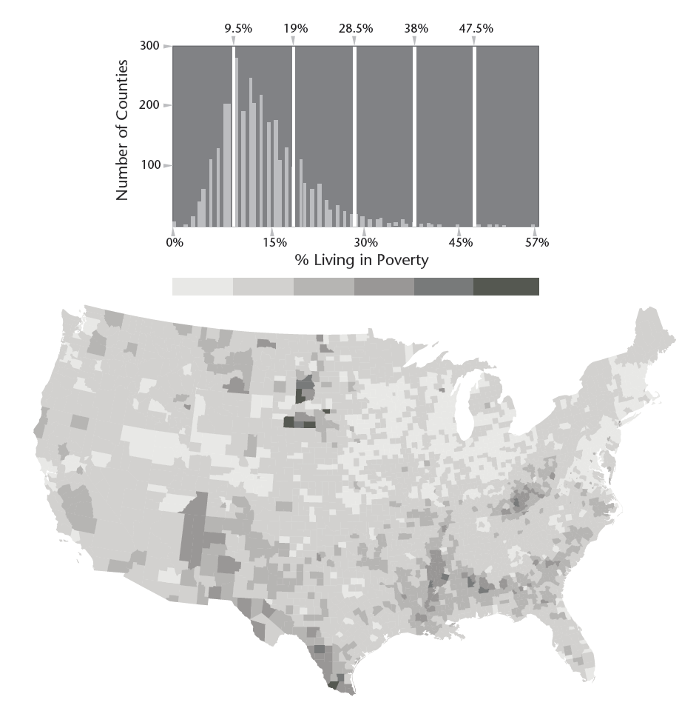
Numeric Classification schemes
Equal interval
Quantile
Natural Breaks
Notes:
Depending your approach, classification methods can paint very different pictures of the same data points.
How might we interpret the natural breaks map differently from the quantiles map here?

Slide 18
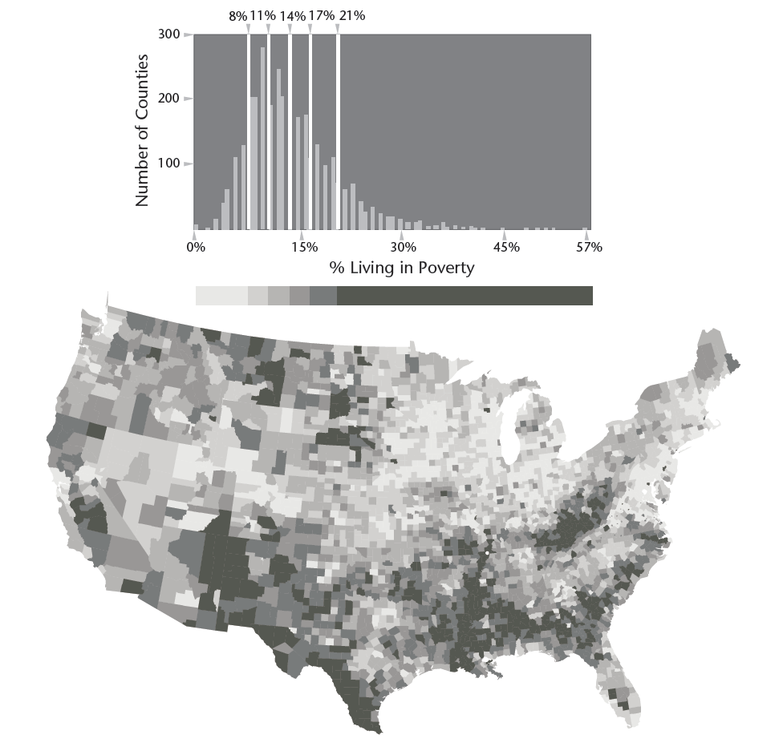
Numeric Classification schemes
Equal interval
Quantile
Natural Breaks
Notes:
Depending your approach, classification methods can paint very different pictures of the same data points.
How might we interpret the natural breaks map differently from the quantiles map here?

Slide 19
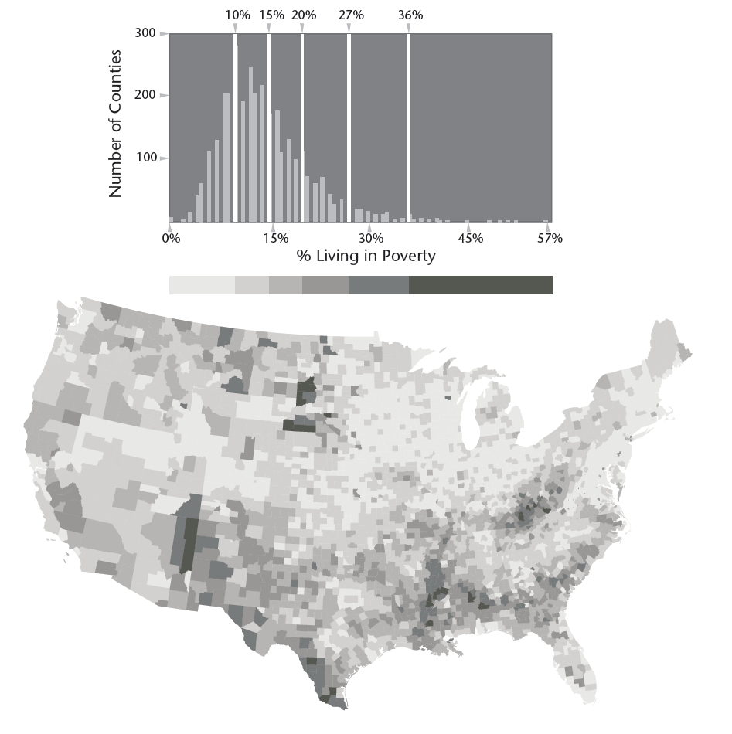
Numeric Classification schemes
Equal interval
Quantile
Natural Breaks
Notes:
Depending your approach, classification methods can paint very different pictures of the same data points.
How might we interpret the natural breaks map differently from the quantiles map here?

Slide 20
Numeric Classification schemes
Equal interval
Quantile
Natural Breaks
Choose based on your data and the analysis you’re doing
Notes:
Depending your approach, classification methods can paint very different pictures of the same data points.
How might we interpret the natural breaks map differently from the quantiles map here?

Slide 21
You try it!
Classify the % College variable into four groups using one of these schemes
Equal interval
Quantile
Natural Breaks
Notes:
Depending your approach, classification methods can paint very different pictures of the same data points.
How might we interpret the natural breaks map differently from the quantiles map here?

